Slide 1
Meeting Presentation: Reinforcement learning of action sequences in table football
Alexandros Kyrloglou
Promotor: Wannes Meert Guidance: Jens Bürger
Wen-Chi Yang

Slide 2
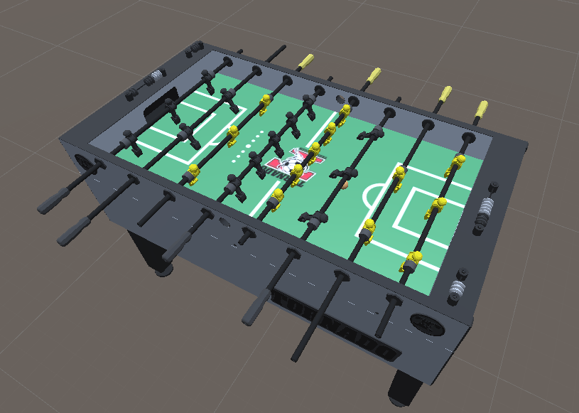
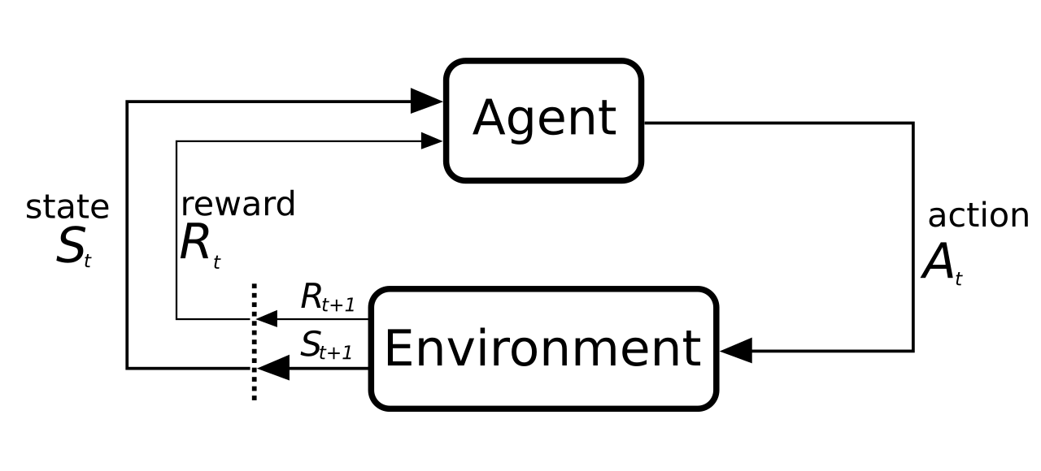
Context & Motivation
Development of robotic foosball.
From theoretic RL implementation to real life robotic implementation.
MDP: {S, A, T, R, p(s₀), 𝛾}
S (continuous)
A (continuous/discrete)
R(S)

Slide 3
Similar Research
Foosball:
Kicker: mainly shooting, RL to Real
EPFL: Decision Tree, Control Engineering
Table Tennis:
ML agent project/competition: similar interaction with the ball
Robotic Arm:
Assembly Tasks: Curriculum Approach, Sim to Real
Robust Continuous Control
Robotic Soccer:
Opponent Modeling

Slide 4
Methodology
Continuous environment
Possible solutions:
Discretization of state-action space
Function approximation for value and/or policy function.
On-policy (PPO) vs Off-policy (SAC)
PPO:
Faster convergence
Computationally cheaper
Low dimensional
SAC:
Data efficient
Exploration
Sparse rewards
Less Hyperparameter tuning

Slide 5
Problem statement
Goal is passing between controllable players.
Types of passes:
Ball control (tick-tacking)
Forward Pass 5 to 3 player:
Static opponent: Non-factor, single position
Dynamic opponent: rhythmic, random static, random movement
Enemy agent
Adding Noise
Transfer: Mirror, Other rod.
Metrics: speed of ball, time to completion, success rate (opponent type).

Slide 6
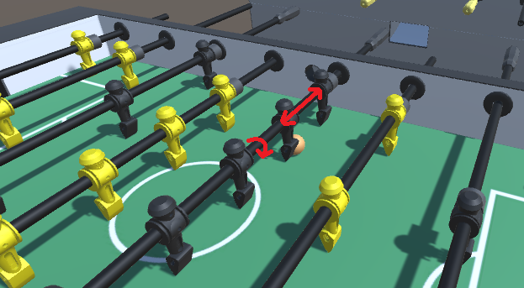
Foosball as an RL environment
CURRENTLY:
Observations
Only Necessary Rods: (x, θ)
Ball: (x, y)
Actions
Translations
Rotations
Discrete on/off
Reward
Denser (Reward shaping)

Slide 7
Foosball as an RL environment
INITIAL IDEA:
Observations
Rods: (x₁, θ₁, x₂, θ₂, x₃, θ₃, x₄, θ₄)
Ball: (x, y)
Actions
4 Translations
4 Rotations
Reward
Sparse (only goal)

Slide 8
Current Progress
Successes:
Environment setup: model, physics, controls
Defining RL environment: ML-agents, Unity, training
Simple task: tick-tack
Complex task setup
Experimenting on:
Observations:
Rod / player
Global / Relative coordinates
Actions:
Discrete choice
Agent setup:
Single / multi agent
PPO / SAC
Reward Function:
Shaping
Curriculum Learning

Slide 9
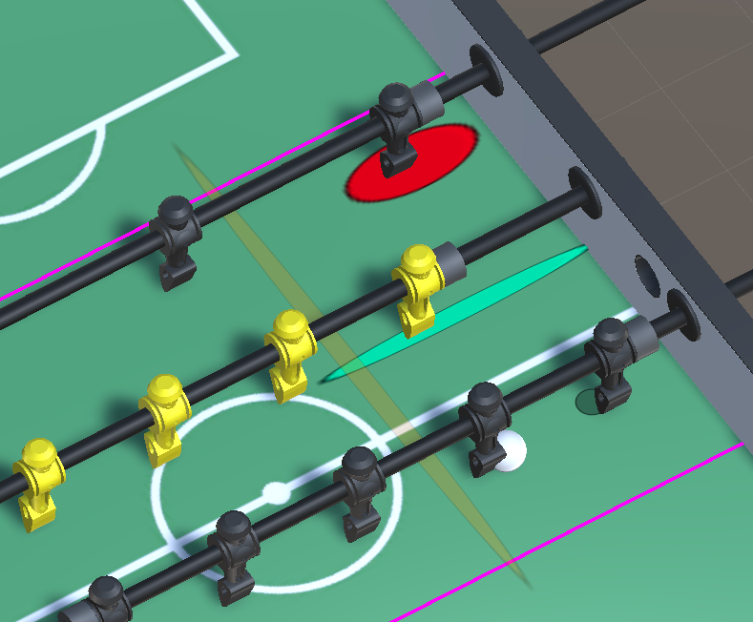
Reward Structure
Both Agents:
Ball in zone (±0.003/action)
Pass Agent:
Touch Passer (+5)
Touch Receiver (+20)
Trigger (±10)
Target (+15)
Loose ball (-10/-20)
Receive Agent:
Touch Receiver (+30)
On Target (+0.01/frame, +10)
Loose ball (-5/-30)
Max
target
lane
trigger
Min

Slide 10
Thank you
References:
De Blasi, Stefano & Klöser, Sebastian & Müller, Arne & Reuben, Robin & Sturm, Fabian & Zerrer, Timo. (2020). KIcker: An Industrial Drive and Control Foosball System automated with Deep Reinforcement Learning. 10.13140/RG.2.2.19201.28003. EPFL Robotic foosball: https://actu.epfl.ch/news/a-robot-to-beat-humans-at-foosball/ Aratrika Basu & Jayantraj Coimbatore Selvakumar & Justin Fu “Learning to play Table Tennis using Multi-agent Reinforcement Learning”. L. Leyendecker, M. Schmitz, H. A. Zhou, V. Samsonov, M. Rittstieg and D. Lütticke, "Deep Reinforcement Learning for Robotic Control in High-Dexterity Assembly Tasks - A Reward Curriculum Approach," 2021 Fifth IEEE International Conference on Robotic Computing (IRC), Taichung, Taiwan, 2021, pp. 35-42, doi: 10.1109/IRC52146.2021.00012. Yuan Zhang, Jianhong Wang, Joschka Boedecker “Robust Reinforcement Learning in Continuous Control Tasks with Uncertainty Set Regularization” Jordan Boyd-Graber, Kevin Kwok, He He “Opponent Modeling in Deep Reinforcement Learning”

